Slide 1
TASTY BYTES / RECIPE DISCOVERY
Can we choose recipes
that draw more traffic to the
Tasty Bytes homepage?
HELD-OUT TEST RESULTS
86.7%
held-out precision
78 / 90
Testing a homepage selection rule
selected recipes were High
80% target
95% interval: 78.1–92.2%
Product-manager briefing | 25 October 2026
01 / 10

Slide 2
TASTY BYTES / RECIPE DISCOVERY
The decision is which recipe to feature each day
Today
Proposed
Decision standard
The manager selects a favorite from available recipes.
Use model scores to rank available recipes.
At least 80% of selected recipes should draw High traffic.
Popular selections have coincided with up to 40% more traffic elsewhere on the site.
The primary metric is precision: the share of selected recipes that lead to High traffic.
Traffic labels support this test. They do not establish subscription lift or a causal homepage effect.
Source: recipe_site_traffic_2212.csv (n=947); analysis dated 25 Oct 2026
02 / 10

Slide 3
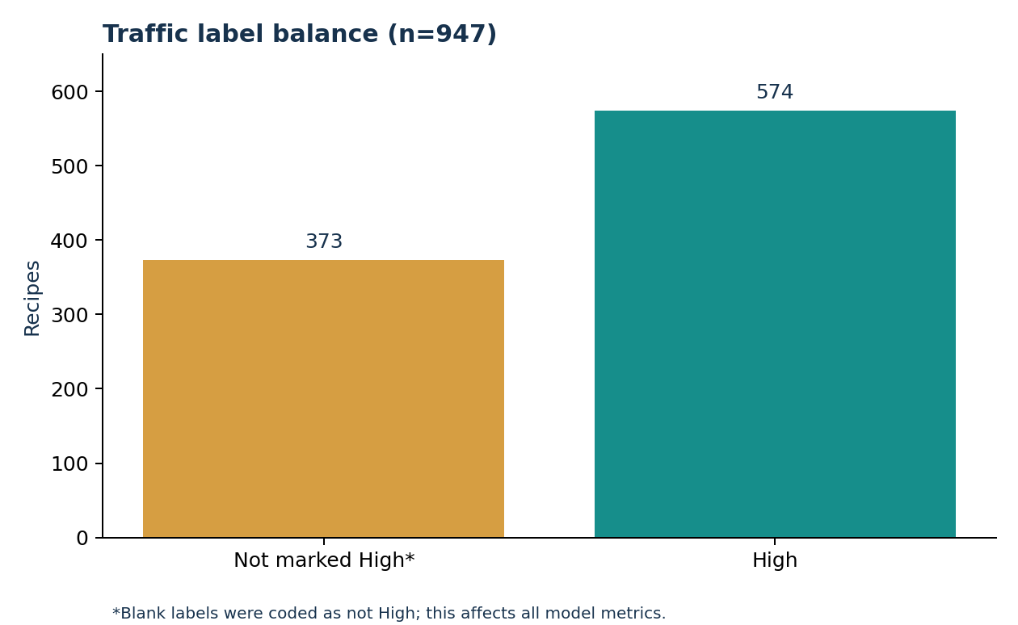
TASTY BYTES / RECIPE DISCOVERY
The dataset is usable for exploration, with one critical label check
947
historical featured recipes
52
rows missing all four nutrients
11
observed categories; brief lists 10
Decision: interpret 373 blank traffic values as not-High for this exercise. Confirm with the product team before any use.
Source: recipe_site_traffic_2212.csv (n=947); analysis dated 25 Oct 2026
03 / 10

Slide 4
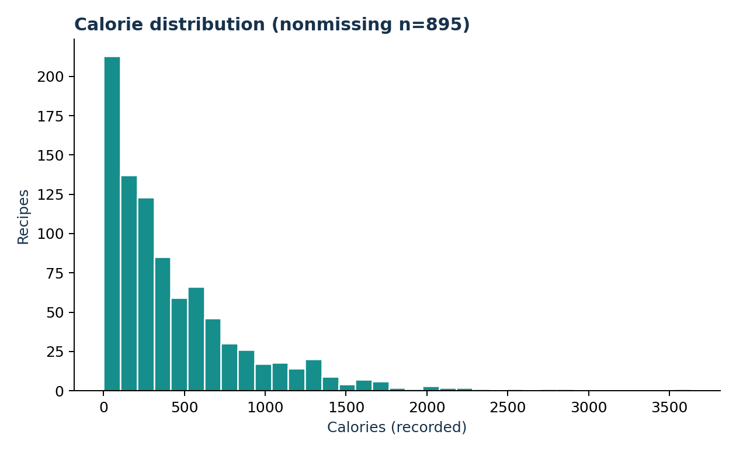
TASTY BYTES / RECIPE DISCOVERY
Recorded calories are strongly right-skewed
Recorded
895 / 947
recipes have calories
Median
288.6
calories per recipe
The long upper tail makes the mean less representative of a typical recipe.
Source: recipe_site_traffic_2212.csv (n=947); analysis dated 25 Oct 2026
04 / 10

Slide 5
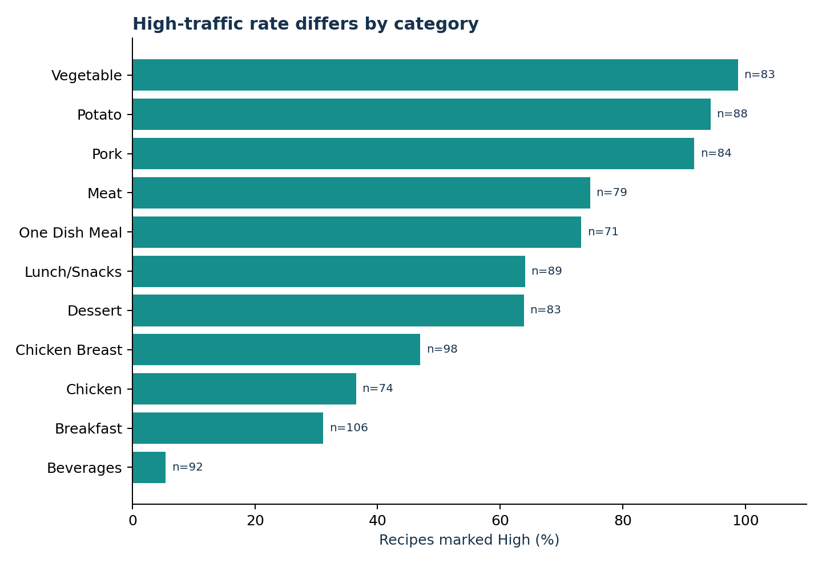
TASTY BYTES / RECIPE DISCOVERY
Category has a strong descriptive association with traffic
Vegetable
82 / 83
marked High
Beverages
5 / 92
marked High
Category is predictive in this sample; it is not evidence that changing category causes more traffic.
Source: recipe_site_traffic_2212.csv (n=947); analysis dated 25 Oct 2026
05 / 10

Slide 6
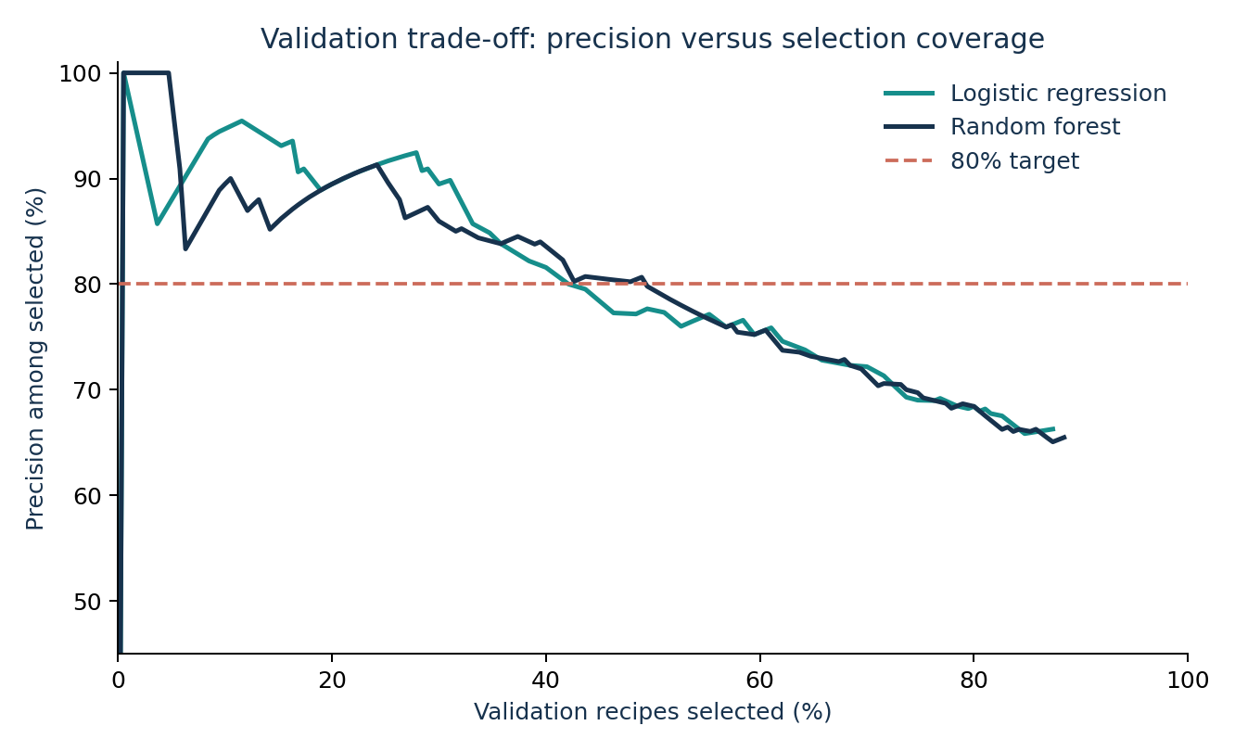
TASTY BYTES / RECIPE DISCOVERY
A conservative threshold meets 80% in validation
Validation set · n=190
Random forest
75 / 93 High · 80.6% precision
48.9% selection coverage
Logistic regression
64 / 80 High · 80.0% precision
42.1% selection coverage
Choice: random forest at score threshold 0.6425; final test set was untouched until selection.
Source: recipe_site_traffic_2212.csv (n=947); analysis dated 25 Oct 2026
06 / 10

Slide 7
TASTY BYTES / RECIPE DISCOVERY
The selection rule reached 86.7% held-out precision
86.7%
47.4%
67.8%
precision among selected
selection coverage
recall of High recipes
78 High among 90 selected
90 selected from 190 recipes
78 found from 115 High
60.5%
→
86.7%
+26.1 pp
all-High baseline precision
model selection precision
Uncertainty matters: Wilson 95% precision interval is 78.1–92.2%, so 80% is not yet statistically secure.
Source: recipe_site_traffic_2212.csv (n=947); analysis dated 25 Oct 2026
07 / 10

Slide 8
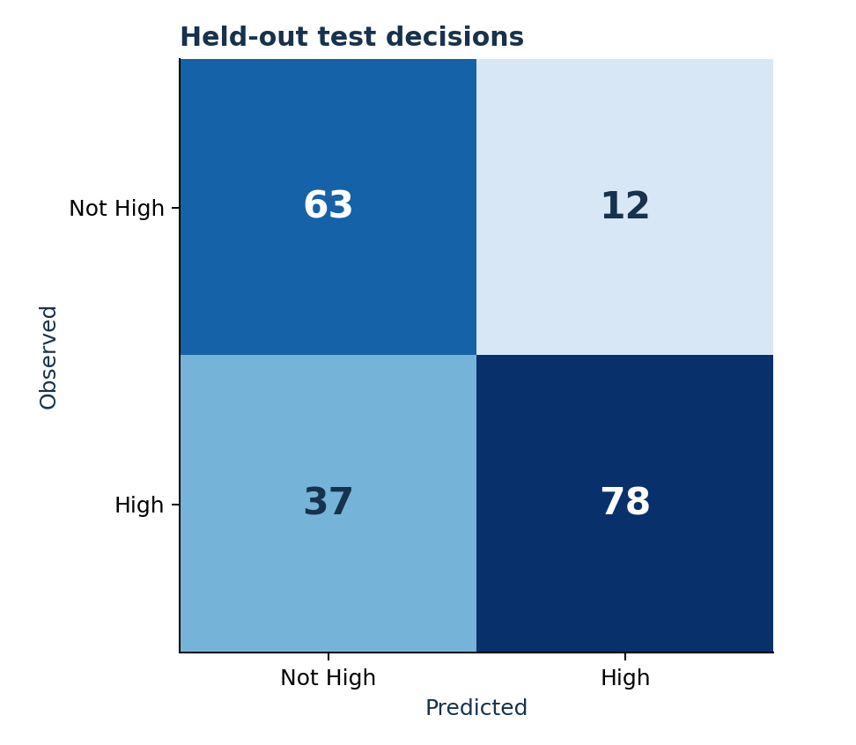
TASTY BYTES / RECIPE DISCOVERY
The model makes errors in both directions
Selected by the model
78
High-traffic recipes
12
not-High recipes
37 High recipes were not selected.
Use the score to narrow choices, with an editorial fallback when no candidate clears the threshold.
Source: recipe_site_traffic_2212.csv (n=947); analysis dated 25 Oct 2026
08 / 10

Slide 9
TASTY BYTES / RECIPE DISCOVERY
Test the rule prospectively before changing the homepage
01
02
03
04
Confirm the label
Log every candidate
Shadow the editor
Randomize the pilot
Resolve whether a blank value means normal traffic or missing measurement.
Capture features, score, placement, exposure, traffic and subscription outcome.
Compare ranked suggestions with actual choices without changing the live page.
Test model-assisted selection against current practice; report lift and uncertainty.
Pilot dashboard: selected-recipe precision and coverage, total site traffic, subscriptions and guardrails by period.
Source: recipe_site_traffic_2212.csv (n=947); analysis dated 25 Oct 2026
09 / 10

Slide 10
TASTY BYTES / RECIPE DISCOVERY
Decision request: approve a monitored, reversible pilot
What I recommend
What this analysis supports
1 Confirm the blank-label meaning.
2 Run the model in shadow mode.
3 Launch a randomized test only after the data and tracking checks pass.
A selection rule to test in a pilot.
Not yet proven: an 80% live hit rate, causal traffic lift, or subscription gain.
Source: recipe_site_traffic_2212.csv (n=947); analysis dated 25 Oct 2026
10 / 10

